Slide 1
Unit –V Elementary UDP SOCKETS

Slide 2
Introduction
There are some fundamental differences between applications written using TCP versus those that use UDP.
These are because of the differences in the two transport layers:
UDP is a connectionless, unreliable, datagram protocol, quite unlike the connection-oriented, reliable byte stream provided by TCP.
Some popular applications are built using UDP: DNS, NFS, and SNMP, for example.

Slide 3
Figure 8.1 shows the function calls for a typical UDP client/server.
The client does not establish a connection with the server.
Instead, the client just sends a datagram to the server using the sendto function, which requires the address of the destination (the server) as a parameter.
Similarly, the server does not accept a connection from a client. Instead, the server just calls the recvfrom function, which waits until data arrives from some client.
recvfrom returns the protocol address of the client, along with the datagram, so the server can send a response to the correct client.

Slide 4
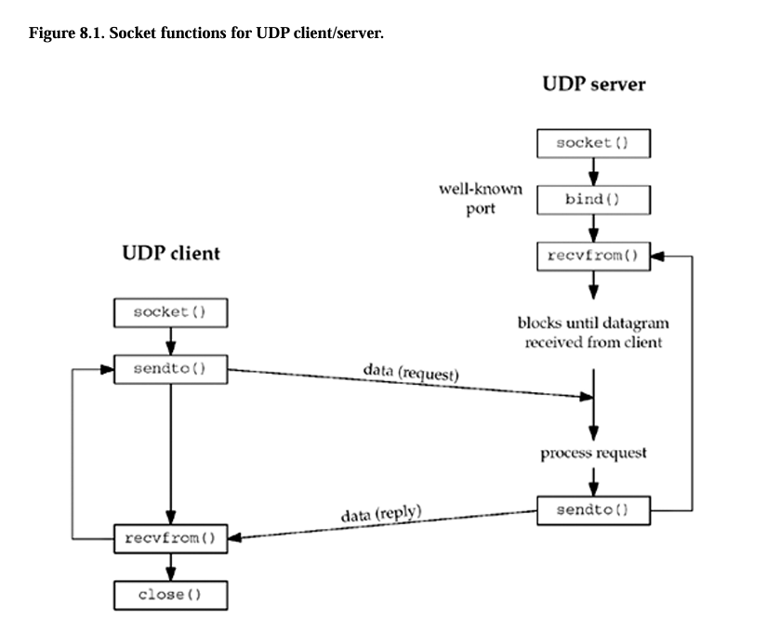

Slide 5
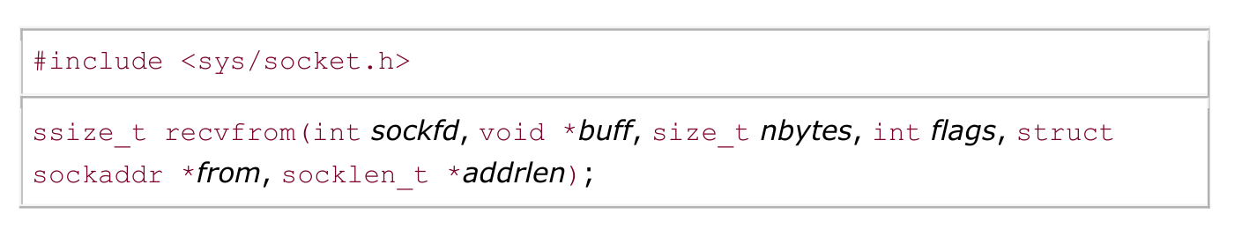
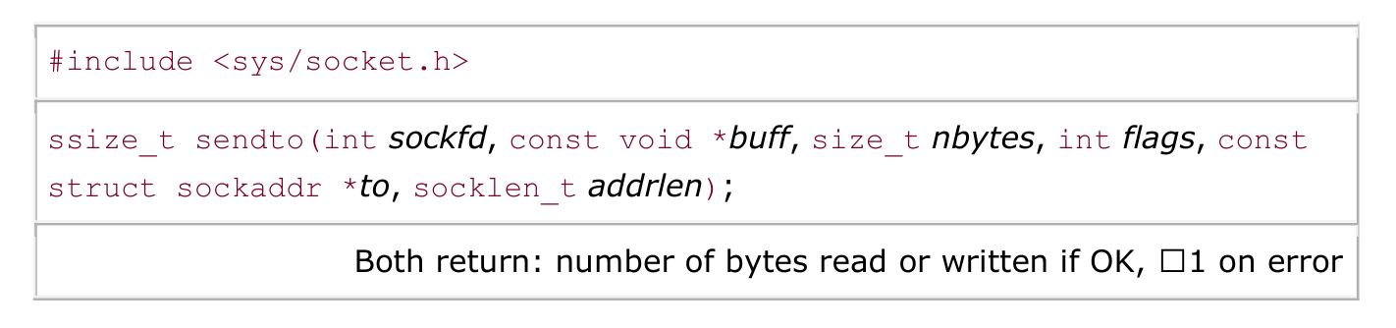
'recvfrom' and 'sendto' Functions
These two functions are similar to the standard read and write functions, but three additional arguments are required.

Slide 6
The first three arguments, sockfd, buff, and nbytes, are identical to the first three arguments for read and write: descriptor, pointer to buffer to read into or write from, and number of bytes to read or write.
The to argument for sendto is a socket address structure containing the protocol address (e.g., IP address and port number) of where the data is to be sent.
The size of this socket address structure is specified by addrlen.
The recvfrom function fills in the socket address structure pointed to by from with the protocol address of who sent the datagram. The number of bytes stored in this socket address structure is also returned to the caller in the integer pointed to by addrlen.
Note that the final argument to sendto is an integer value, while the final argument to recvfrom is a pointer to an integer value (a value-result argument).

Slide 7
The final two arguments to recvfrom are similar to the final two arguments to accept: The contents of the socket address structure upon return tell us who sent the datagram (in the case of UDP) or who initiated the connection (in the case of TCP).
The final two arguments to sendto are similar to the final two arguments to connect: We fill in the socket address structure with the protocol address of where to send the datagram (in the case of UDP) or with whom to establish a connection (in the case of TCP).
Both functions return the length of the data that was read or written as the value of the function.
In the typical use of recvfrom, with a datagram protocol, the return value is the amount of user data in the datagram received.

Slide 8
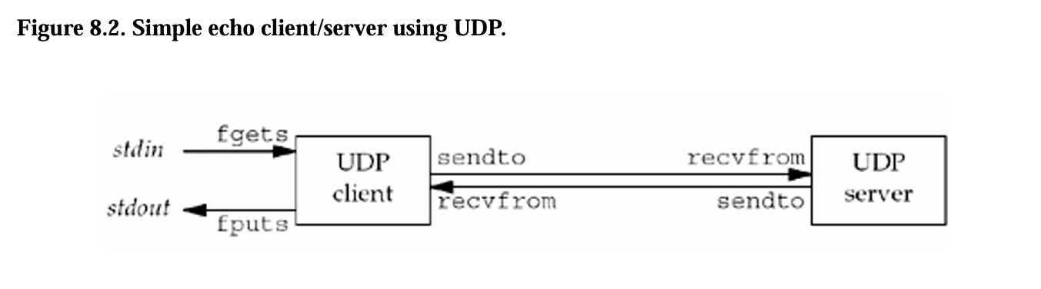
UDP Echo Server: 'main' Function

Slide 9
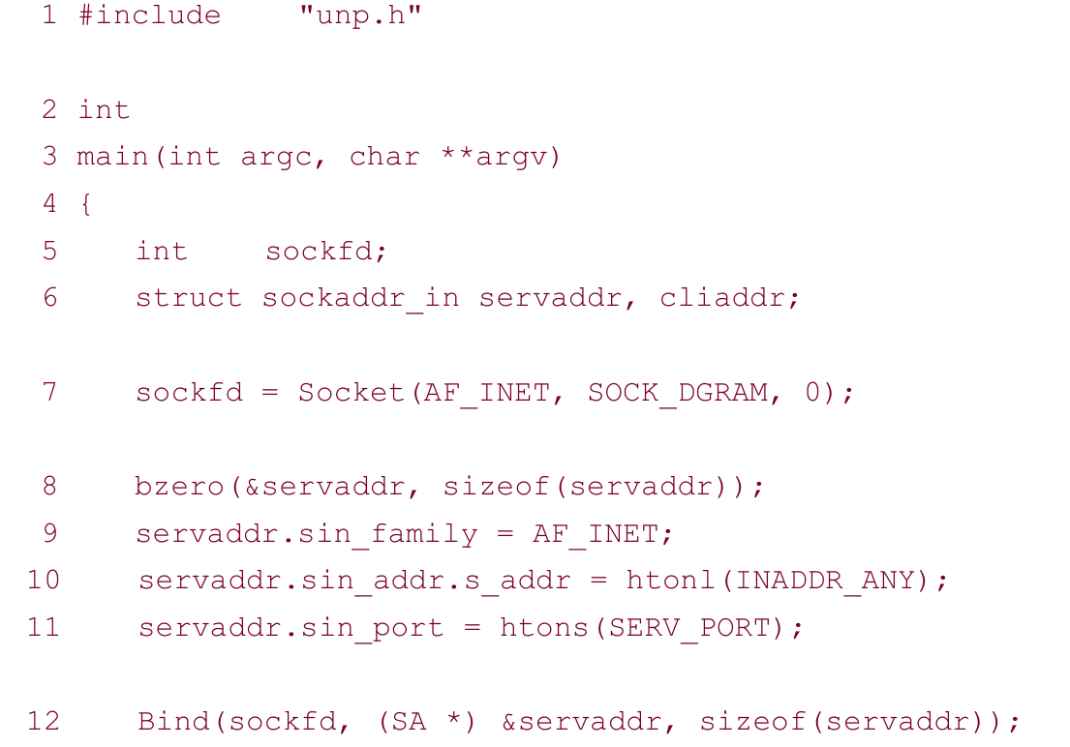
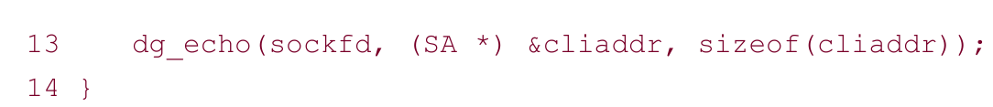

Slide 10
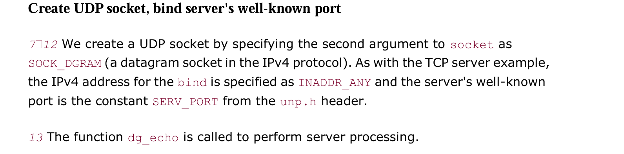

Slide 11
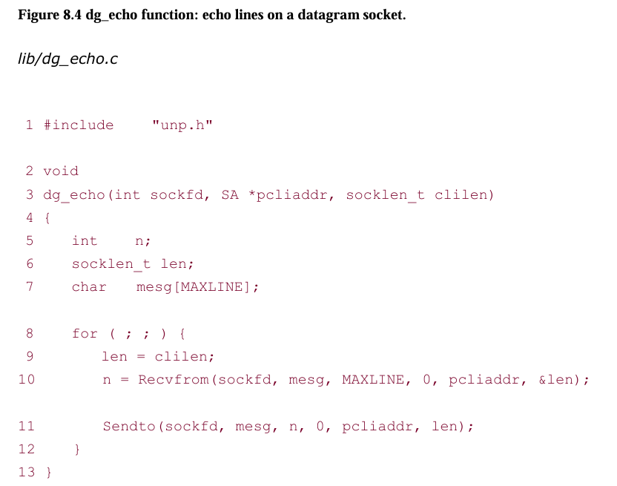
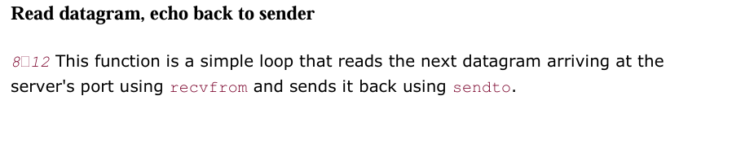
UDP Echo Server: 'dg_echo' Function

Slide 12
dg_echo function is protocol-independent.
The reason dg_echo is protocol-independent is because the caller (the main function in our case) must allocate a socket address structure of the correct size, and a pointer to this structure, along with its size, are passed as arguments to dg_echo.
The function dg_echo never looks inside this protocol-dependent structure:
It simply passes a pointer to the structure to recvfrom and sendto.
recvfrom fills this structure with the IP address and port number of the client, and since the same pointer (pcliaddr) is then passed to sendto as the destination address, this is how the datagram is echoed back to the client that sent the datagram.

Slide 13
Despite the simplicity of this function, there are numerous details to consider. First, this function never terminates. Since UDP is a connectionless protocol, there is nothing like an EOF as we have with TCP.
Next, this function provides an iterative server, not a concurrent server as we had with TCP. There is no call to fork, so a single server process handles any and all clients. In general, most TCP servers are concurrent and most UDP servers are iterative.
There is implied queuing taking place in the UDP layer for this socket. Indeed, each UDP socket has a receive buffer and each datagram that arrives for this socket is placed in that socket receive buffer.
When the process calls recvfrom, the next datagram from the buffer is returned to the process in a first-in, first-out (FIFO) order.
This way, if multiple datagrams arrive for the socket before the process can read what's already queued for the socket, the arriving datagrams are just added to the socket receive buffer. But, this buffer has a limited size.

Slide 14
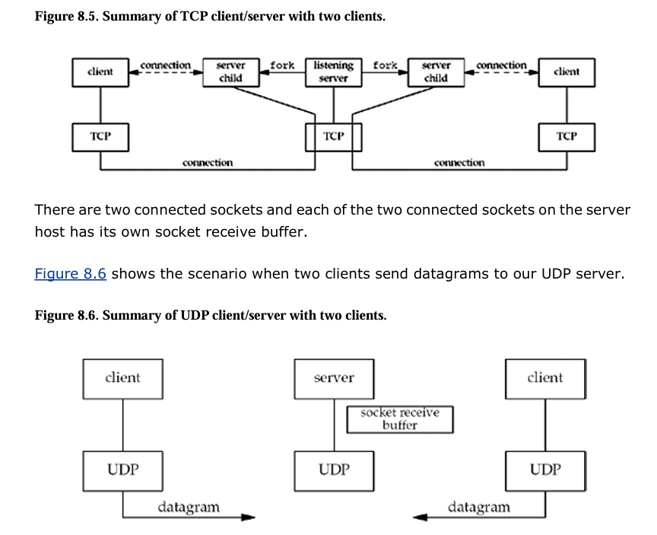

Slide 15
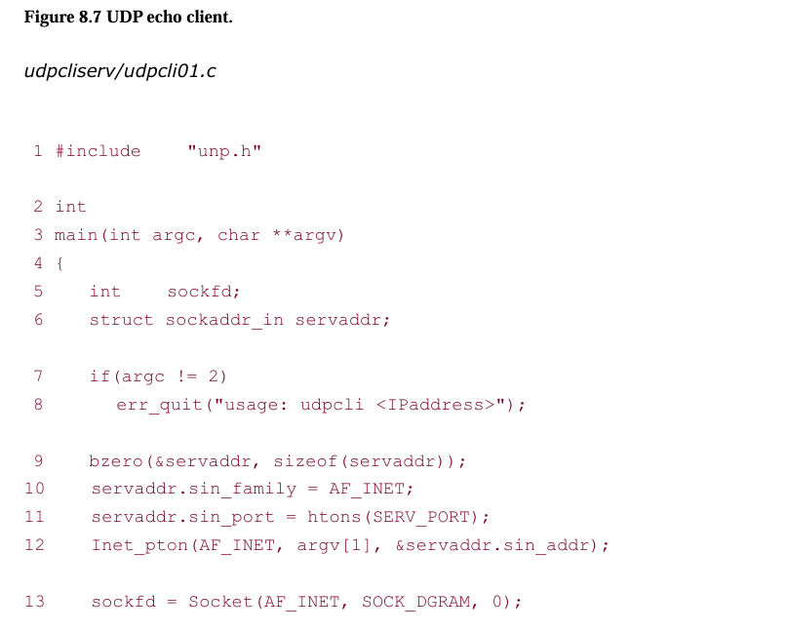
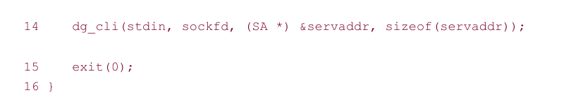
UDP Echo Client: 'main' Function

Slide 16
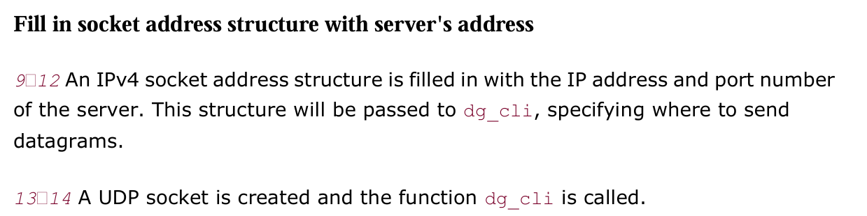

Slide 17
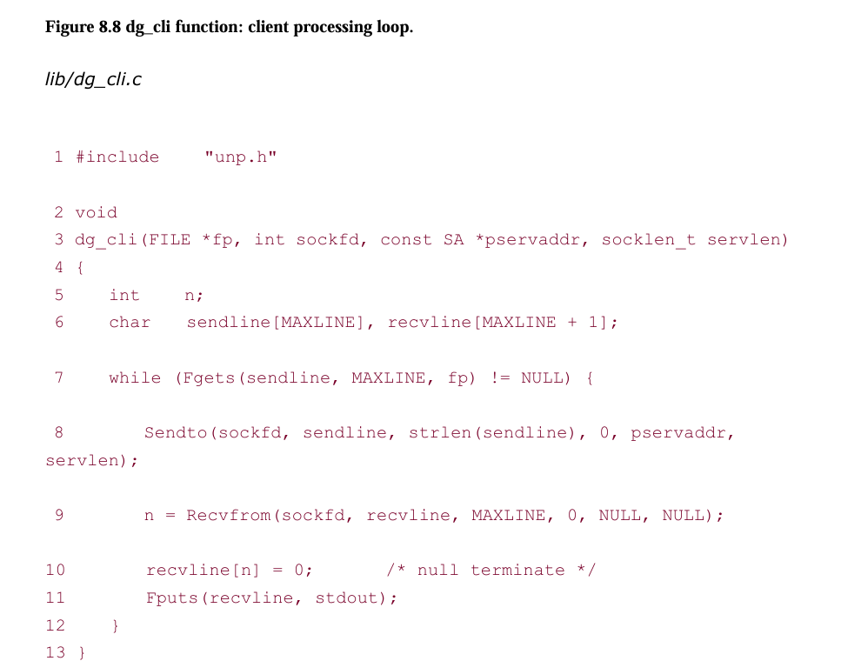
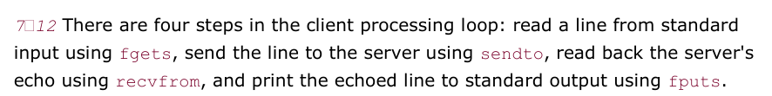
UDP Echo Client: 'dg_cli' Function

Slide 18
Our client has not asked the kernel to assign an ephemeral port to its socket. (With a TCP client, we said the call to connect is where this takes place.) With a UDP socket, the first time the process calls sendto, if the socket has not yet had a local port bound to it, that is when an ephemeral port is chosen by the kernel for the socket. As with TCP, the client can call bind explicitly, but this is rarely done. .
Notice that the call to recvfrom specifies a null pointer as the fifth and sixth arguments. This tells the kernel that we are not interested in knowing who sent the reply. There is a risk that any process, on either the same host or some other host, can send a datagram to the client's IP address and port, and that datagram will be read by the client, who will think it is the server's reply.
As with the server function dg_echo, the client function dg_cli is protocol-independent, but the client main function is protocol-dependent. The main function allocates and initializes a socket address structure of some protocol type and then passes a pointer to this structure, along with its size, to dg_cli.

